Slide 1

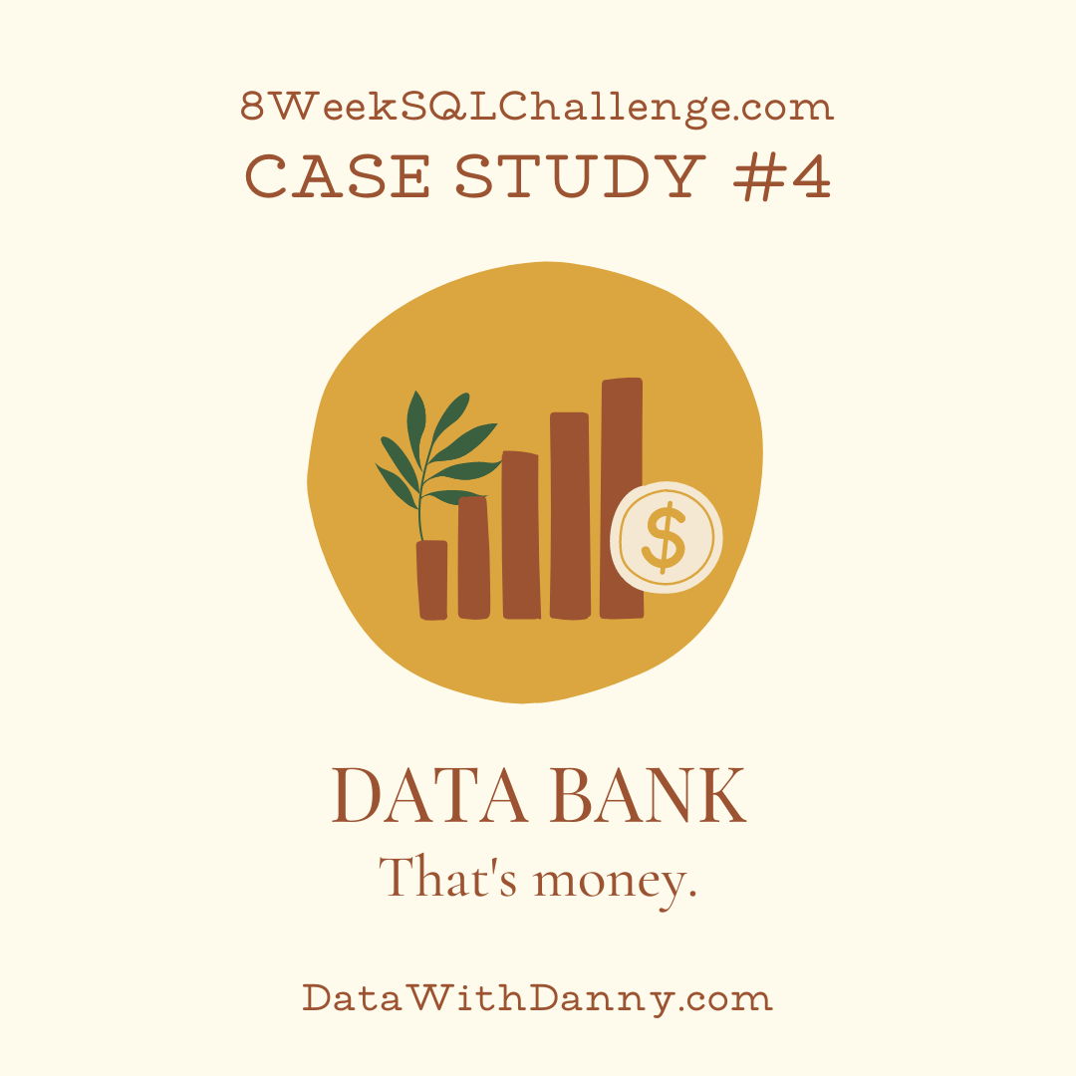
SQL Challenge #4 DATA BANK
By Kanishka Garg

Slide 2
PROBLEM STATEMENT
There is a new innovation in the financial industry called Neo-Banks: new aged digital only banks without physical branches.
Danny thought that there should be some sort of intersection between these new age banks, cryptocurrency and the data world…so he decides to launch a new initiative - Data Bank!
Data Bank runs just like any other digital bank - but it isn’t only for banking activities, they also have the world’s most secure distributed data storage platform!
Customers are allocated cloud data storage limits which are directly linked to how much money they have in their accounts. There are a few interesting caveats that go with this business model, and this is where the Data Bank team need your help!
The management team at Data Bank want to increase their total customer base - but also need some help tracking just how much data storage their customers will need.
This case study is all about calculating metrics, growth and helping the business analyze their data in a smart way to better forecast and plan for their future developments!

Slide 3
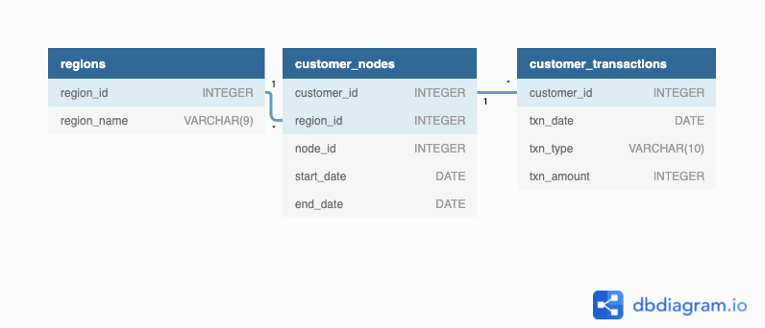
Entity relationship diagram

Slide 4
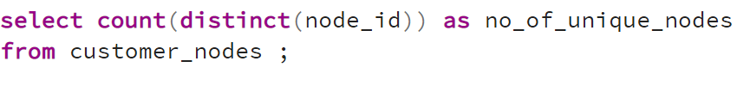
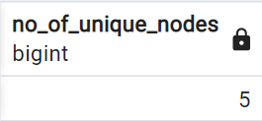
Q1: How many unique nodes are there on the Data Bank system?
Customer Nodes Exploration

Slide 5
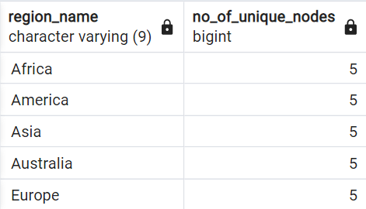
Q2: What is the number of nodes per region?

Slide 6
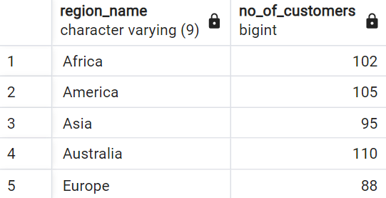
Q3: How many customers are allocated to each region?

Slide 7
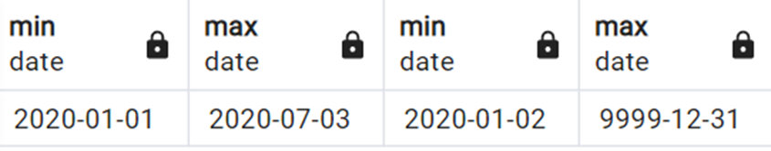
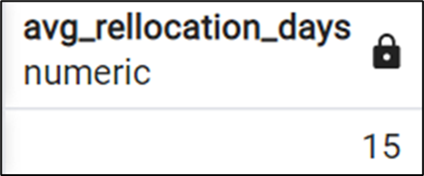
Q4: How many days on average are customers reallocated to a different node?
First, I need to know that if there is any outlier in the dataset or not. Hence, I used first query to know about max and min for each column. Then I got to know that there is one outlier in the set i.e. max of end date with year 9999. Hence, I used filter option while computing average allocation days.

Slide 8
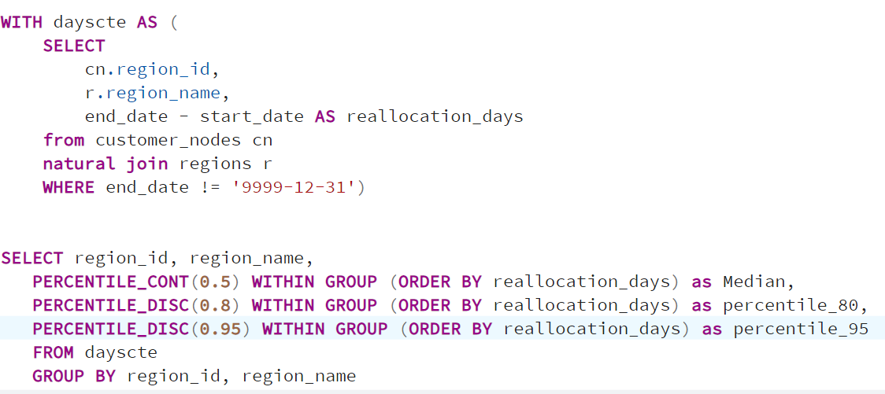
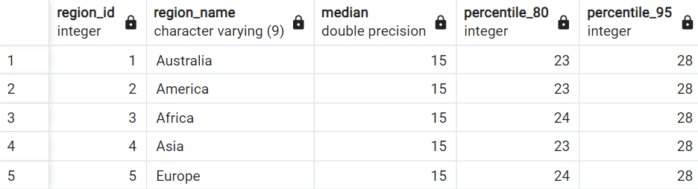
Q5: What is the median, 80th and 95th percentile for this same reallocation days metric for each region?

Slide 9
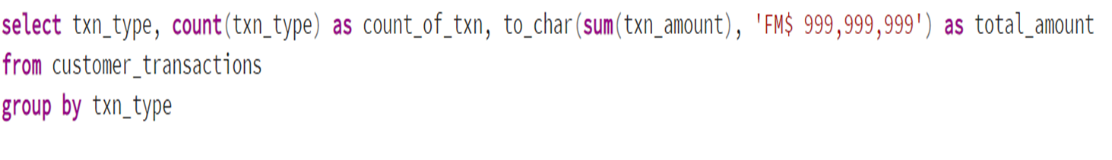
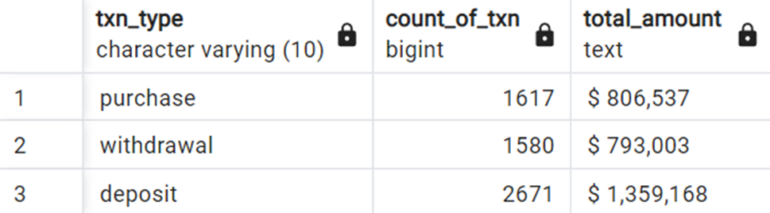
Q1: What is the unique count and total amount for each transaction type?
Customer Transactions

Slide 10
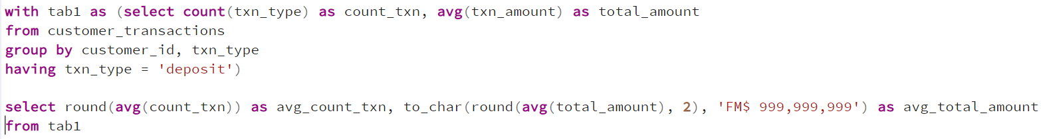

Q2: What is the average total historical deposit counts and amounts for all customers?

Slide 11
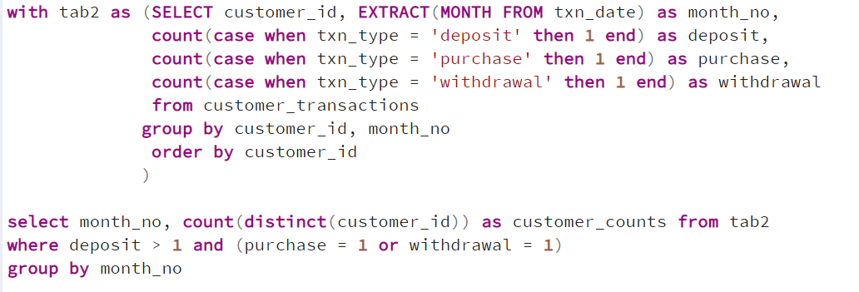
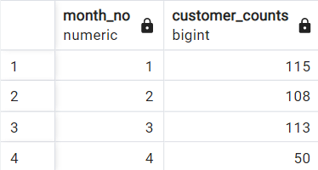
Q3: or each month - how many Data Bank customers make more than 1 deposit and either 1 purchase or 1 withdrawal in a single month?

Slide 12
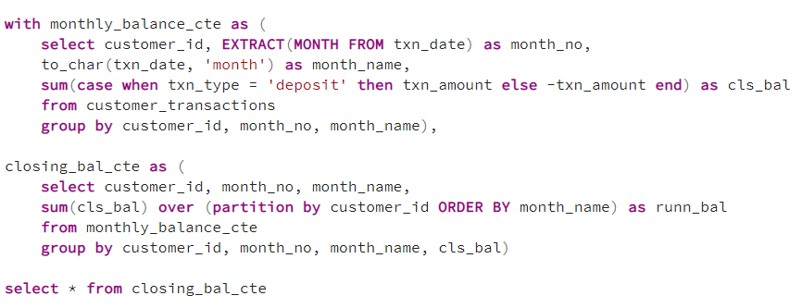
Q4: What is the closing balance for each customer at the end of the month?

Slide 13
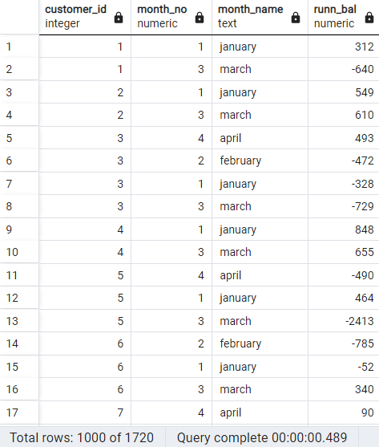
Output for ques 4:

Slide 14
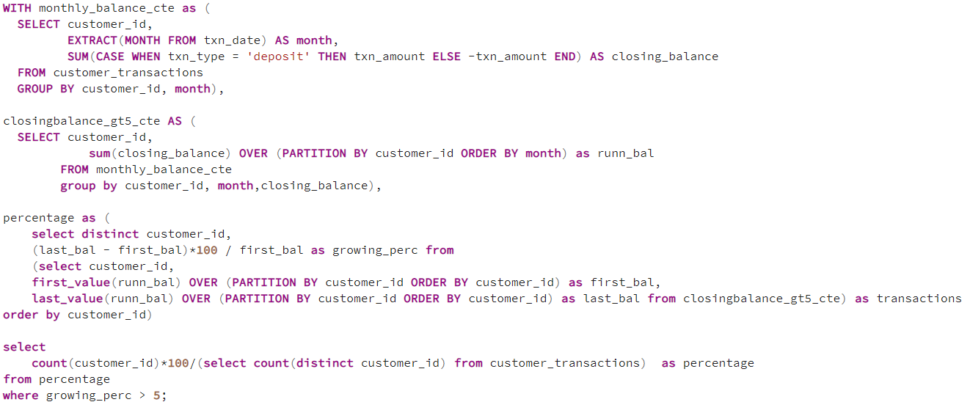

Q5: What is the percentage of customers who increase their closing balance by more than 5%?

